Slide 1
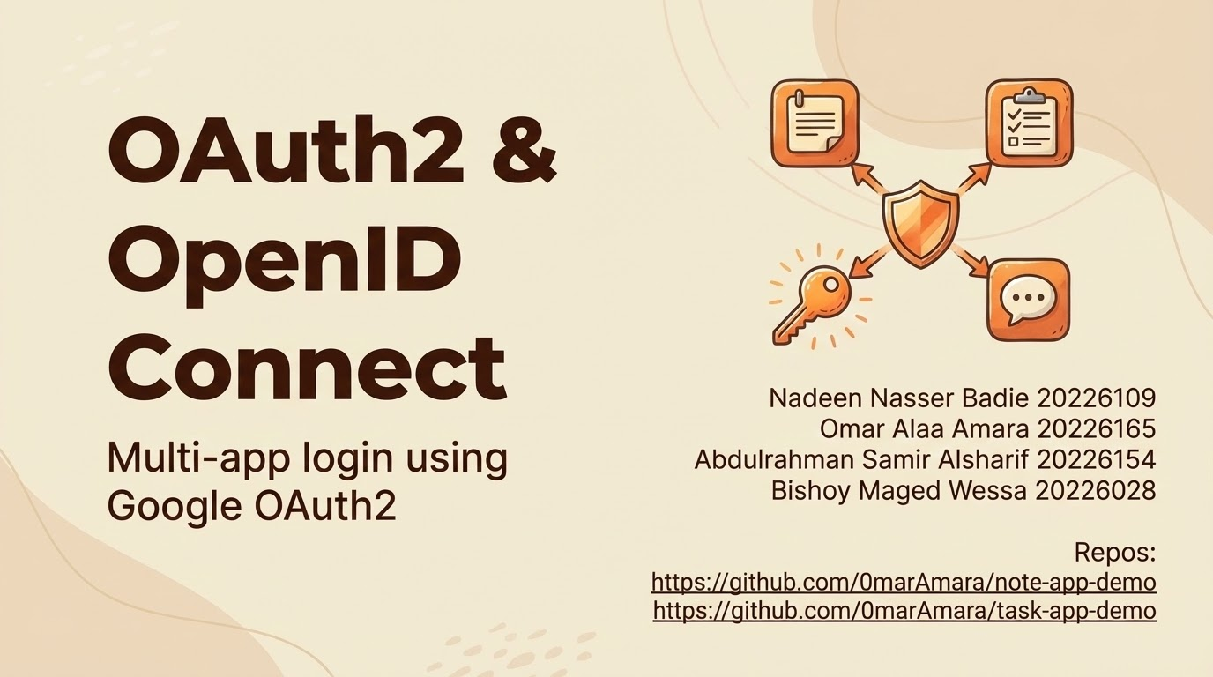
Repos:
https://github.com/0marAmara/note-app-demo
https://github.com/0marAmara/task-app-demo

Slide 2
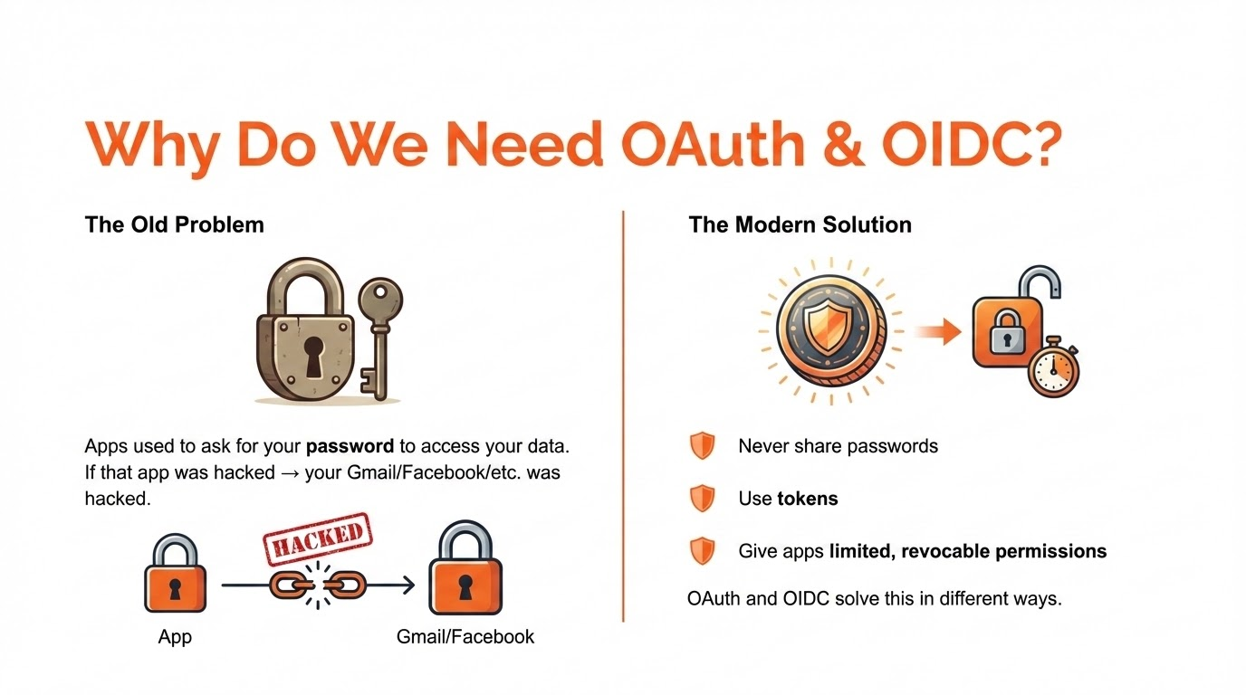

Slide 3
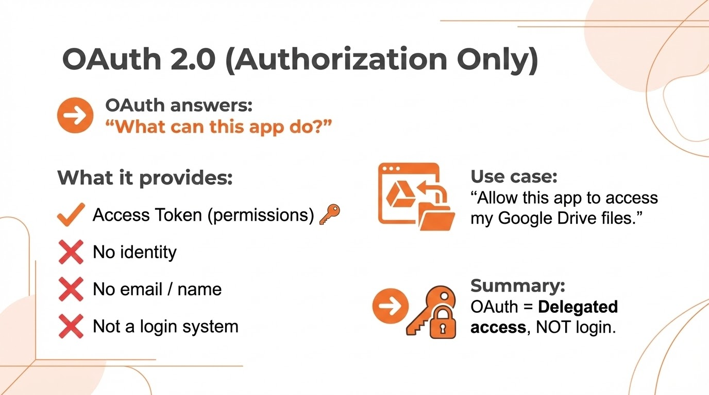

Slide 4
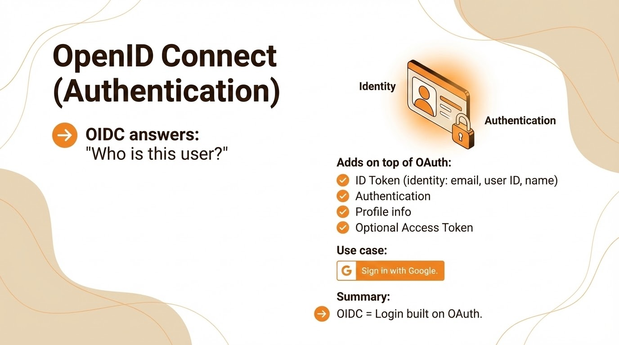

Slide 5
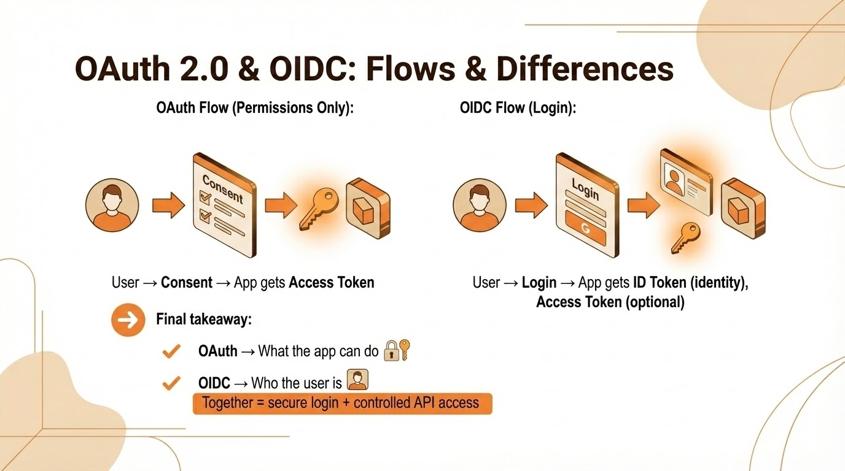

Slide 6
